Slide 1
Adversarial Representation Mechanism Learning for Network Embedding
TKDE 2021
Code: github.com/wt-tju/ArmGAN/
2021.12.14 • ChongQing
Reported by Chenghong Li

Slide 2
Introduction
Existing GAN-based methods typically use GAN to learn a Gaussian distribution as a prior for network embedding, which makes it difficult to distinguish the node representation from Gaussian distribution.
We propose a novel adversarial learning framework consisting of three players for network embedding, which applies the adversarial learning strategy on the representation mechanism.

Slide 3
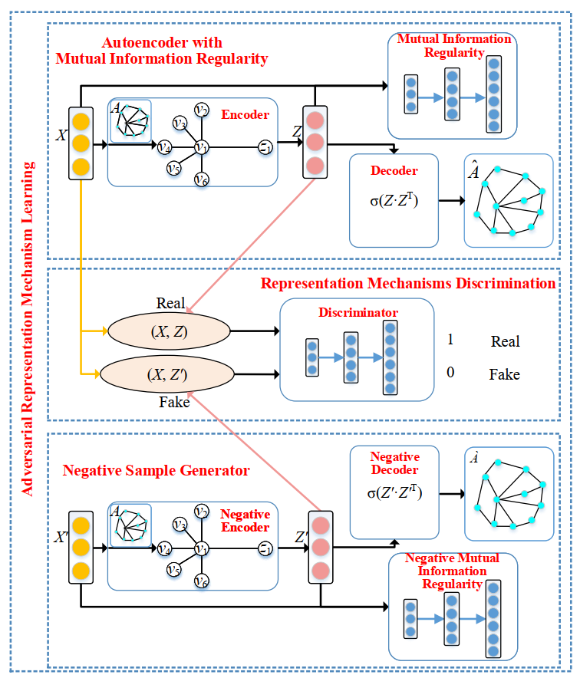
Method

Slide 4
Method

Slide 5
AAAI_2021_Data Augmentation for Graph Neural Networks

Slide 6
Method
“MINE: Mutual information neural estimation,” ICML, 2018.

Slide 7
Method

Slide 8
Method

Slide 9
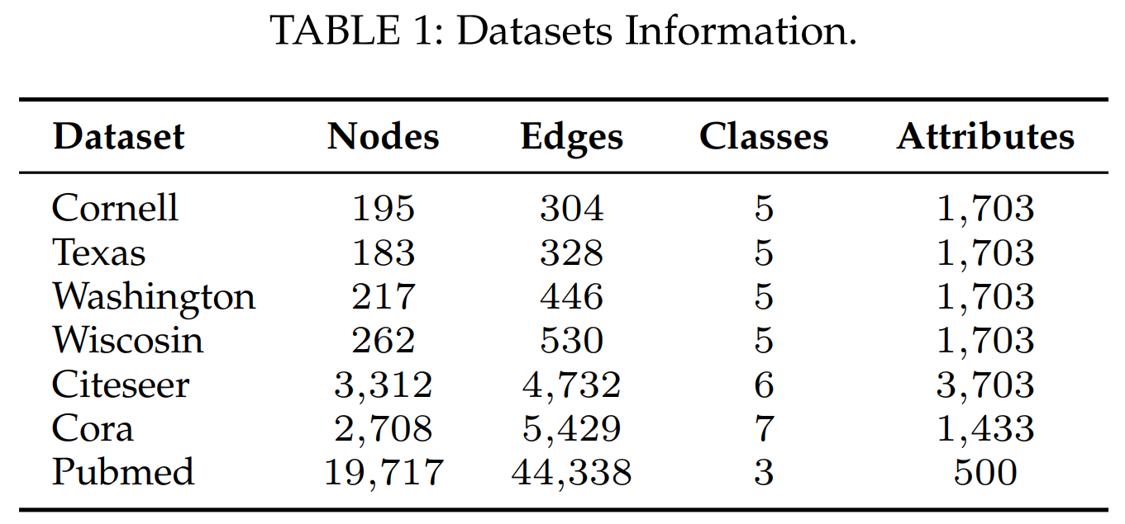
Experiments

Slide 10
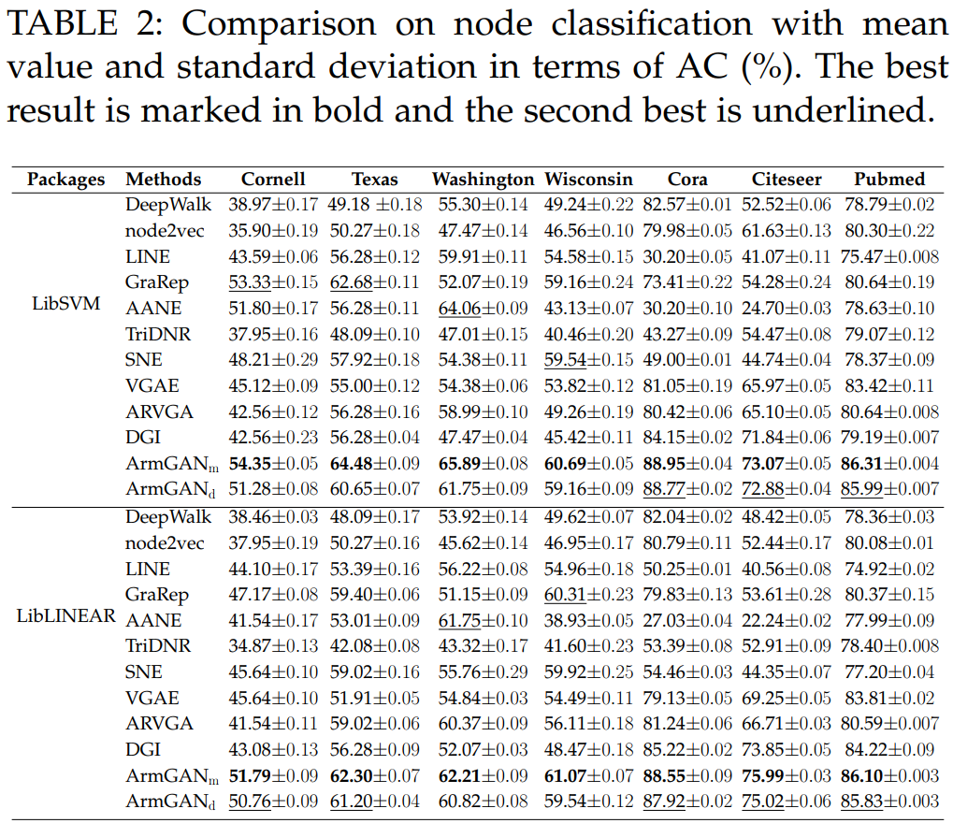
Experiments

Slide 11
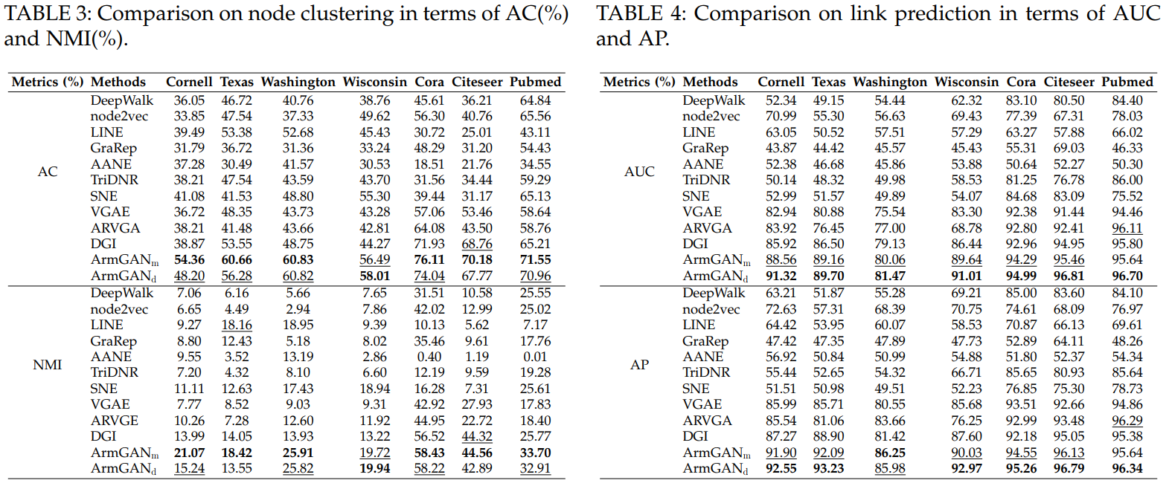
Experiments

Slide 12
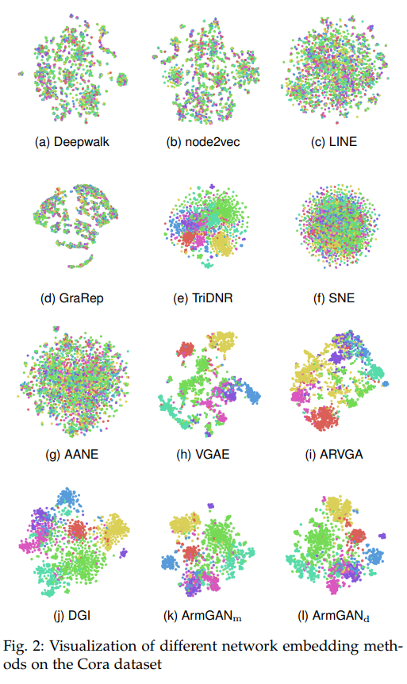
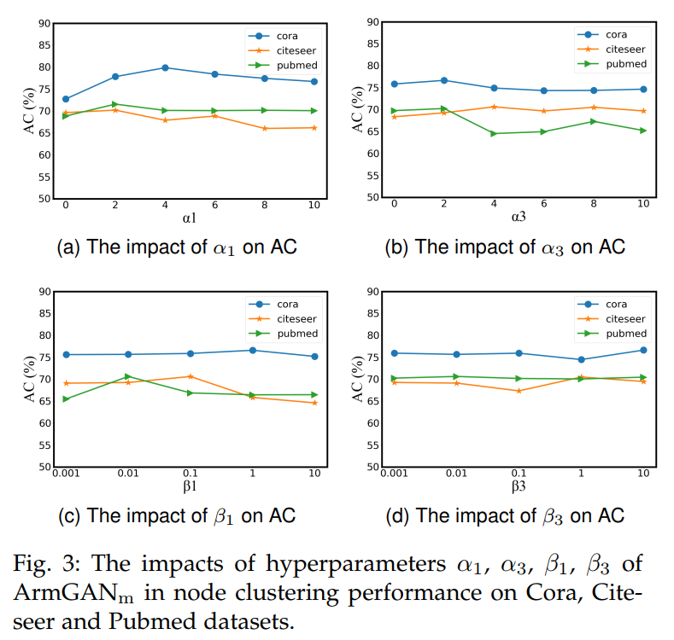
Experiments

Slide 13
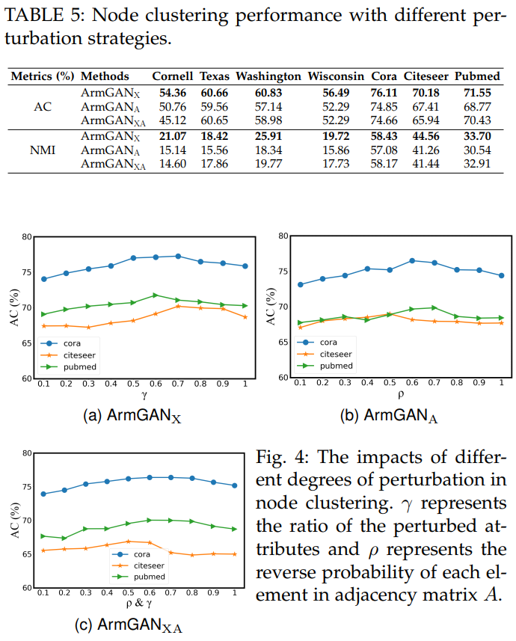
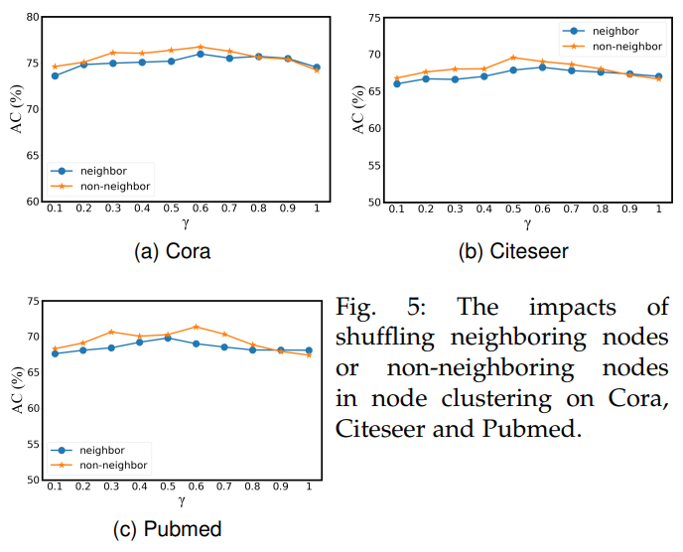
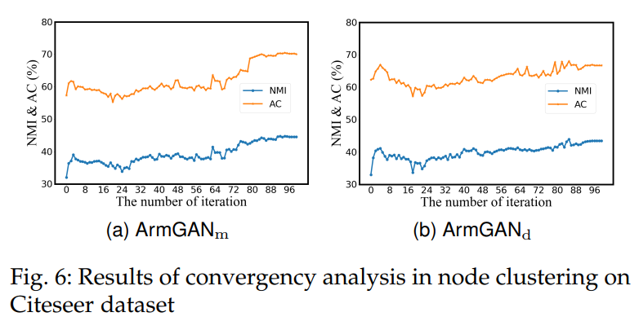
Experiments

Slide 14
Thanks

